Slide 1

Altair Datathon
Analysis of Predictive Machine Maintenance for Optimal Operations
Ujjwal Raj
IIITDM Kancheepuram

Slide 2
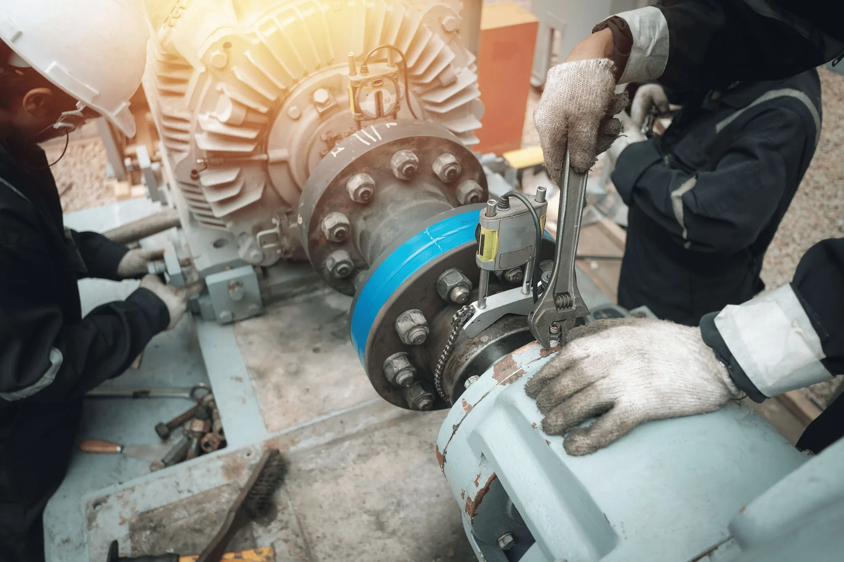
Introduction
Problem: Machine failures in manufacturing lead to costly downtime and safety risks. Predictive maintenance is crucial for preventing such issues and ensuring optimal operations.
Goal: Develop a robust predictive model using machine learning techniques to accurately forecast machine failures, thereby minimizing downtime and optimizing production processes.
Dataset Source: Kaggle
Link:https://www.kaggle.com/datasets/shivamb/machine-predictive-maintenance-classification
Tools used: (Altair AI Studio, RapidMiner).

Slide 3
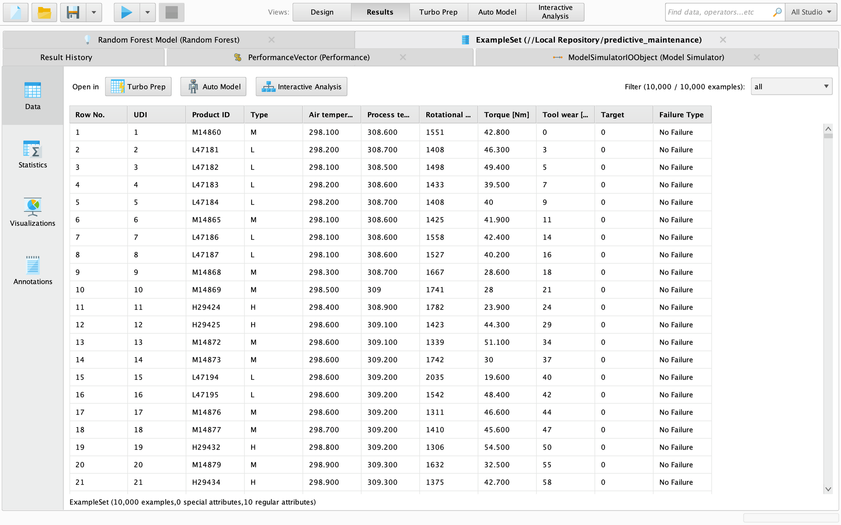
Dataset Overview
Key Features and Insights for Predictive Maintenance are as follows.
Key dataset statistics: 10,000 data points, 14 features.
List essential features affecting machine failures: Air temperature, Process temperature, Rotational speed, Torque, Tool wear, Product type.
Importance: Feature selection ensures relevant data is utilized, while proper preparation enhances model accuracy, enabling effective prediction of machine failures for proactive maintenance strategies.

Slide 4
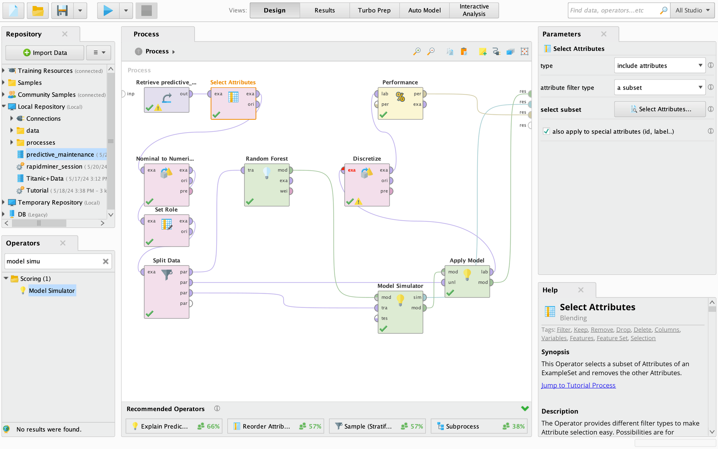
Data Preprocessing
Preparing for Analysis
Preprocessing Steps: We curated data by selecting relevant features and converting nominal to numerical values. This streamlined dataset preparation for accurate model training and prediction of machine failures.
Rationale: Feature selection removes irrelevant attributes, focusing on predictive factors. Converting nominal to numerical enhances model compatibility, ensuring effective analysis and prediction accuracy.

Slide 5
Model Training
Building Predictive Capacity: Used Random Forest for Machine Failure Prediction.
Model Selection: Random Forest algorithm chosen for its ensemble of decision trees, offering robust prediction capabilities for complex datasets.
Justifying the Choice: I chose Random Forest because it mitigates overfitting, handles large datasets efficiently, and provides insights into feature importance for enhanced model interpretability.
Training Process: I partitioned the dataset using stratified sampling to maintain class distribution integrity. This ensured balanced representation across training subsets, crucial for model generalization. Then, employing the Random Forest algorithm, then I iteratively trained decision trees with randomized subsets of data, mitigating overfitting and enhancing predictive performance. Through this process, our model learned complex patterns and relationships within the data, enabling accurate prediction of machine failures in diverse operational scenarios.

Slide 6
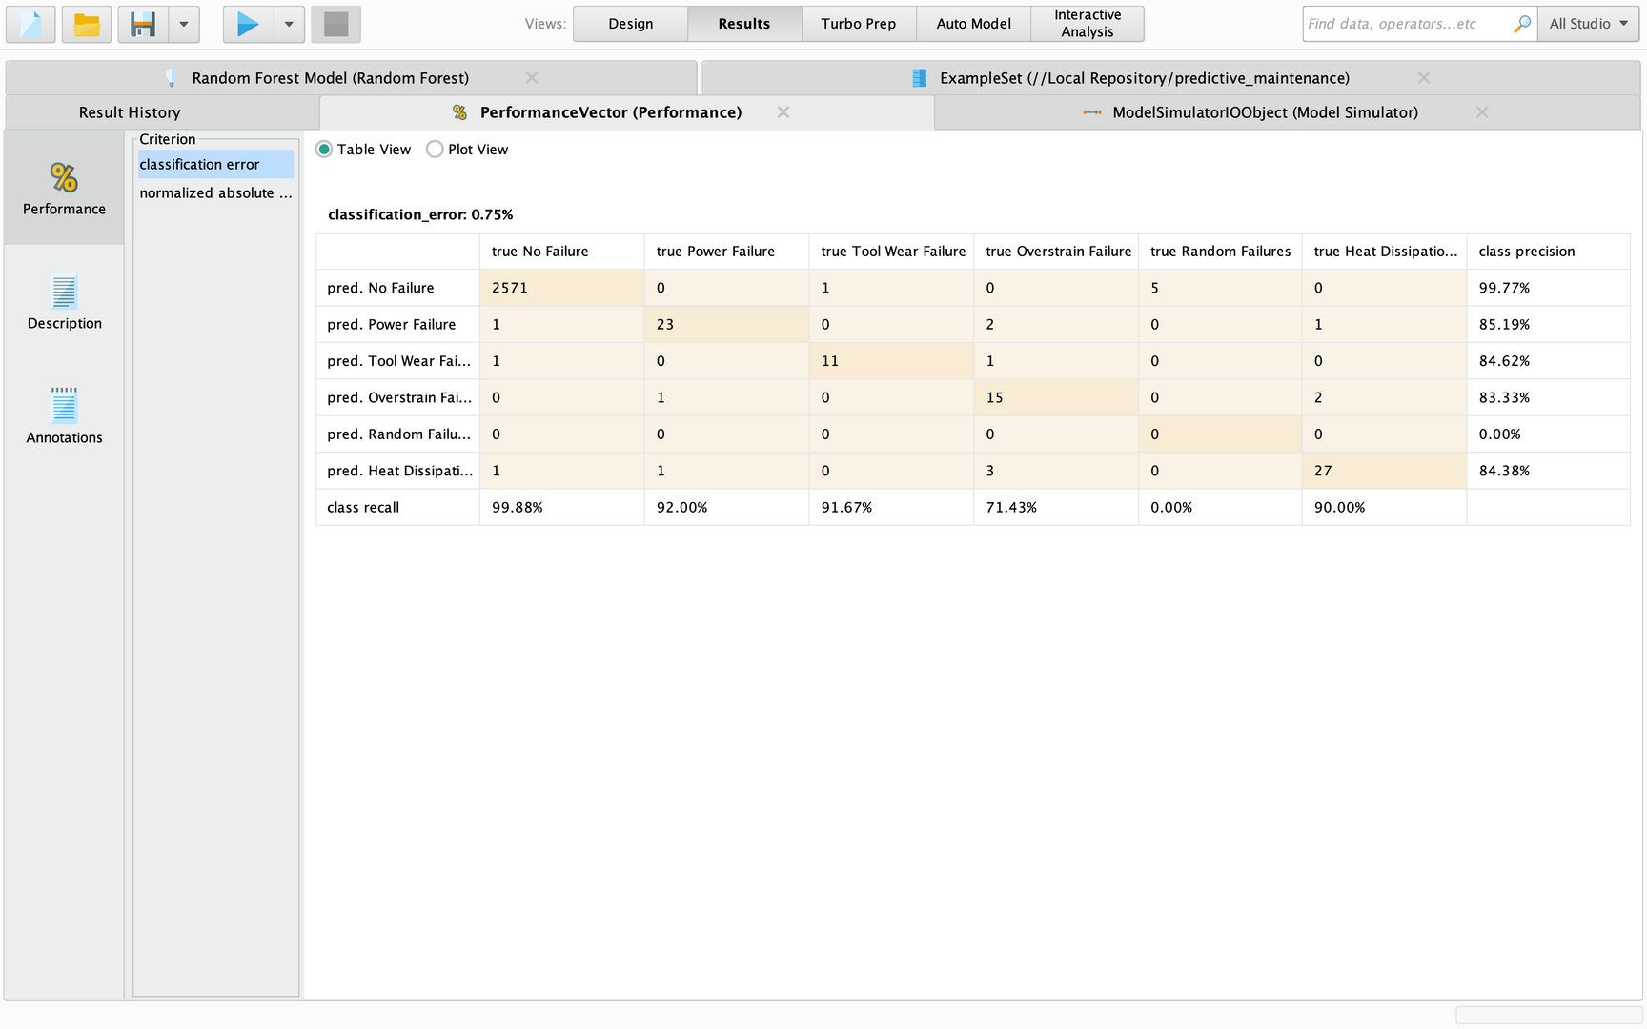
Performance Matrix Analysis
1) Impressive Accuracy: Our model makes very few mistakes, with only a 0.75% error rate, giving it a high 99.25% accuracy, which is really good.
2) Getting it Right: Out of 2577 times when there was no failure, our model only got it wrong 6 times, showing has predicted 99.77% accurately.
3) Good at Spotting Problems: It's great at forecasting various problems like power failure (85.19%), tool wear (84.62%), and overstrain (83.33%).
4) No False Alarms: It never wrongly said there was a random failure, meaning it's good at not giving false alarms.
5)Always Improving: While it's good at predicting heat dissipation failures (84.38%), there's always room to make it even better for predictive maintenance.
With 99.25% overall accuracy and low classification error (0.75%) our model is very accurate.

Slide 7
Model Evaluation - Recall Analysis
Title: Assessing Predictive Precision and Exploring Recall Rates for Different Failure Types.
Discussion: Our model exhibits strong recall rates across various failure types. Notably, it accurately identifies power failures 92% of the time, tool wear failures 91.67% of the time, and heat dissipation failures 90% of the time. These high rates ensure effective detection of actual positive cases, facilitating proactive maintenance interventions for optimal operational performance.
High Recall Rates Highlighted: Our model excels in capturing critical failure instances, boasting impressive recall rates of 92% for power failures, 91.67% for tool wear failures, and 90% for heat dissipation failures, ensuring proactive maintenance for seamless operations.

Slide 8
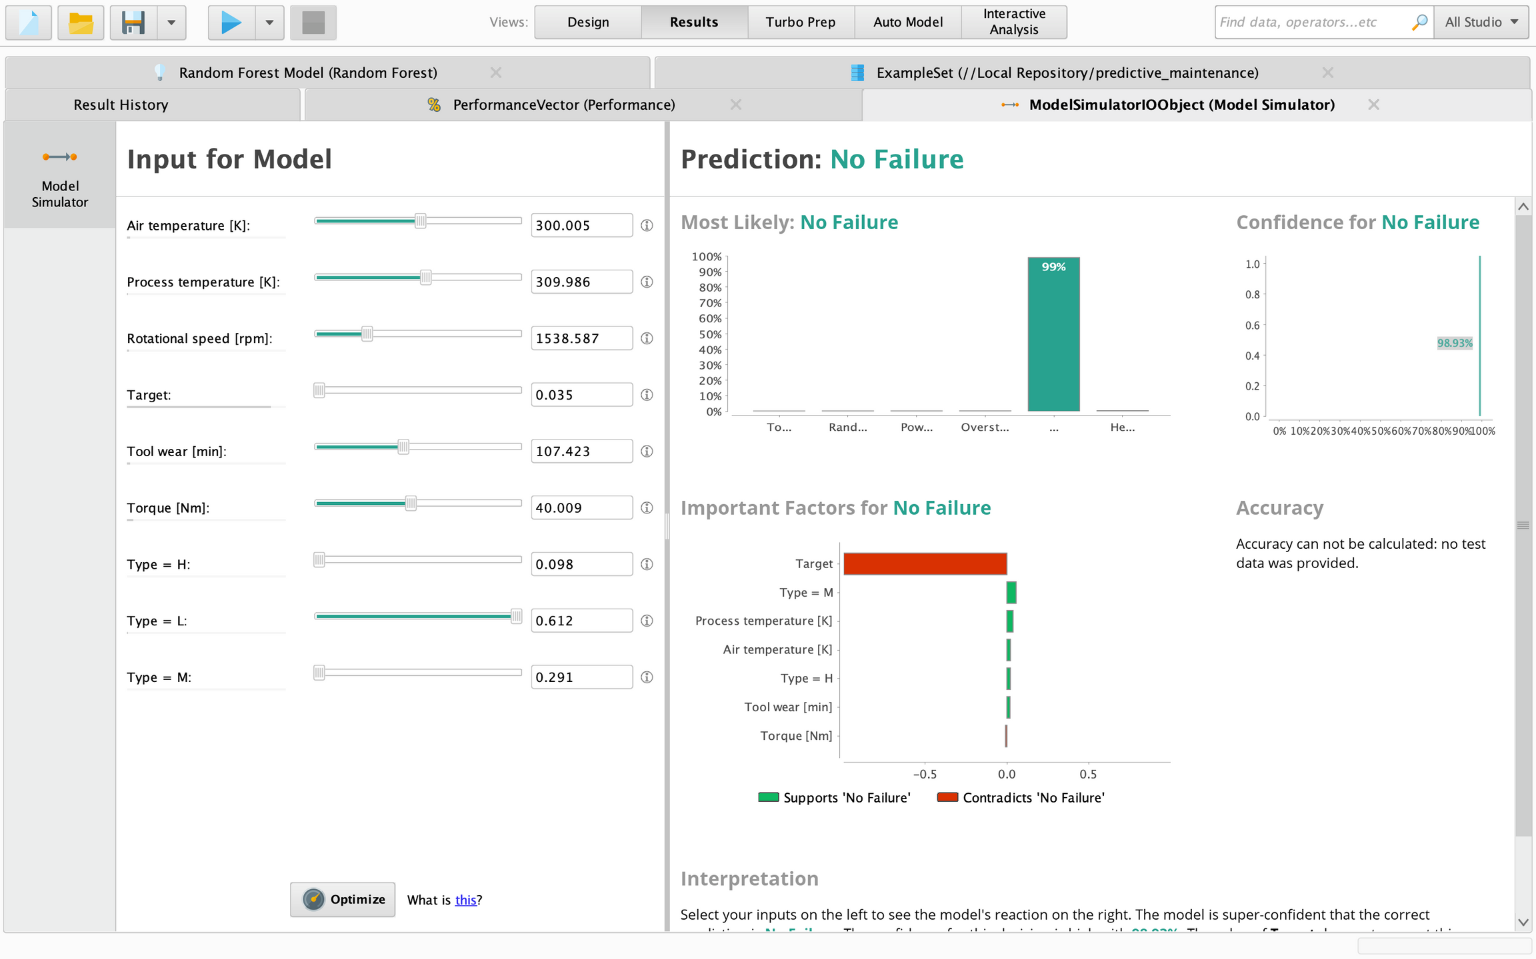
Model Simulator

Slide 9
Model Simulator Analysis
1) In the model simulator of our model, the input variables are as follows:
Air temperature: 300.005K
Process temperature: 309.986K
Rotational speed: 1538.587 rpm
Torque: 40.009 Nm
Target: 0.035
Type L: 0.612
Type M: 0.291
Type H: 0.098
2) The prediction based on these inputs is:
i) Most likely, there is no failure.
ii) Confidence of no failure is 98.93%.
iii) All the attributes support that under these input variables, the chance of no failure is 99%.
Interpreting the results, when we increase the rotational speed, torque, and tool contact time, the chances of failure also increase.

Slide 10
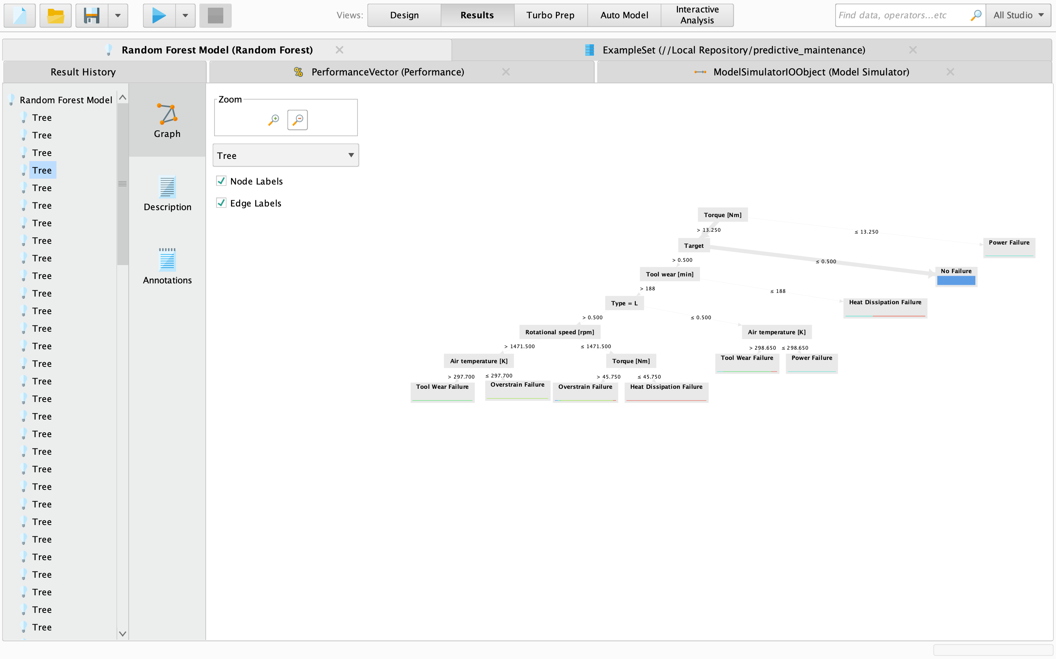
Decision Tree Insights
Highlight insights from decision trees: Conditions leading to different failure types are revealed through distinct decision paths. Each path delineates specific attribute thresholds indicating the likelihood of particular failure scenarios, aiding in proactive maintenance strategies.
For example : Where torque is below 13.250 and the target is less than 0.5, there's a remarkable 99.99% likelihood of no failure. Conversely, when torque and target surpass 13.25 and 0.5 respectively, and tool wear time remains under 188, the probability of heat dissipation issues escalates, underscoring the criticality of monitoring these parameters.

Slide 11
Conclusion
1) Summary of Findings:In conclusion, our predictive machine maintenance model highlights optimal operational conditions. For instance, when input attributes align as Air temperature: 300.005K, Process temperature: 309.986K, Rotational speed: 1538.587 rpm, Torque: 40.009 Nm, Target: 0.035, and types L=0.612, M=0.291, H=0.098, the risk of tool failure significantly decreases, indicating ideal conditions for efficient machine operation.
2) Benefits of Using Our Model:Using our model has many benefits. It helps us find problems with machines before they happen, so we can fix them before they cause any issues. This prevents unexpected stops in production and saves money. Plus, it helps us plan maintenance better, which lowers costs and keeps production running smoothly. Overall, our model makes workplaces safer, more efficient, and more profitable.

Slide 12
Thank You
Contact Details :
Name: Ujjwal Raj
LinkedIn: Click here
IIITDM Kancheepuram

